Slide 1
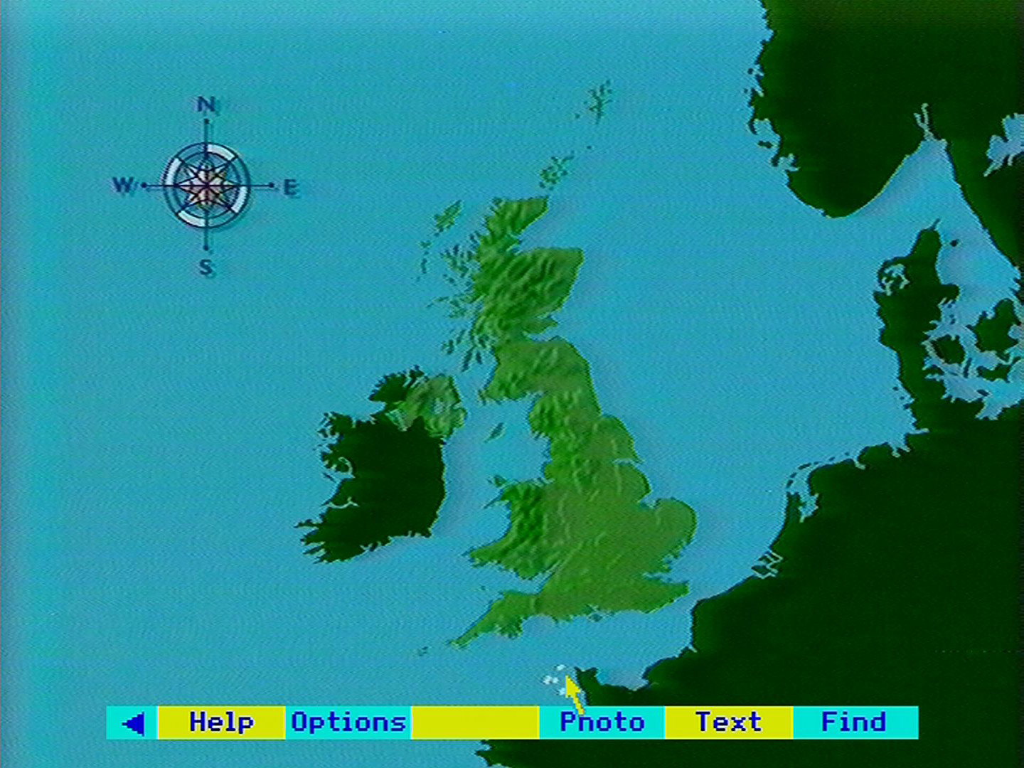
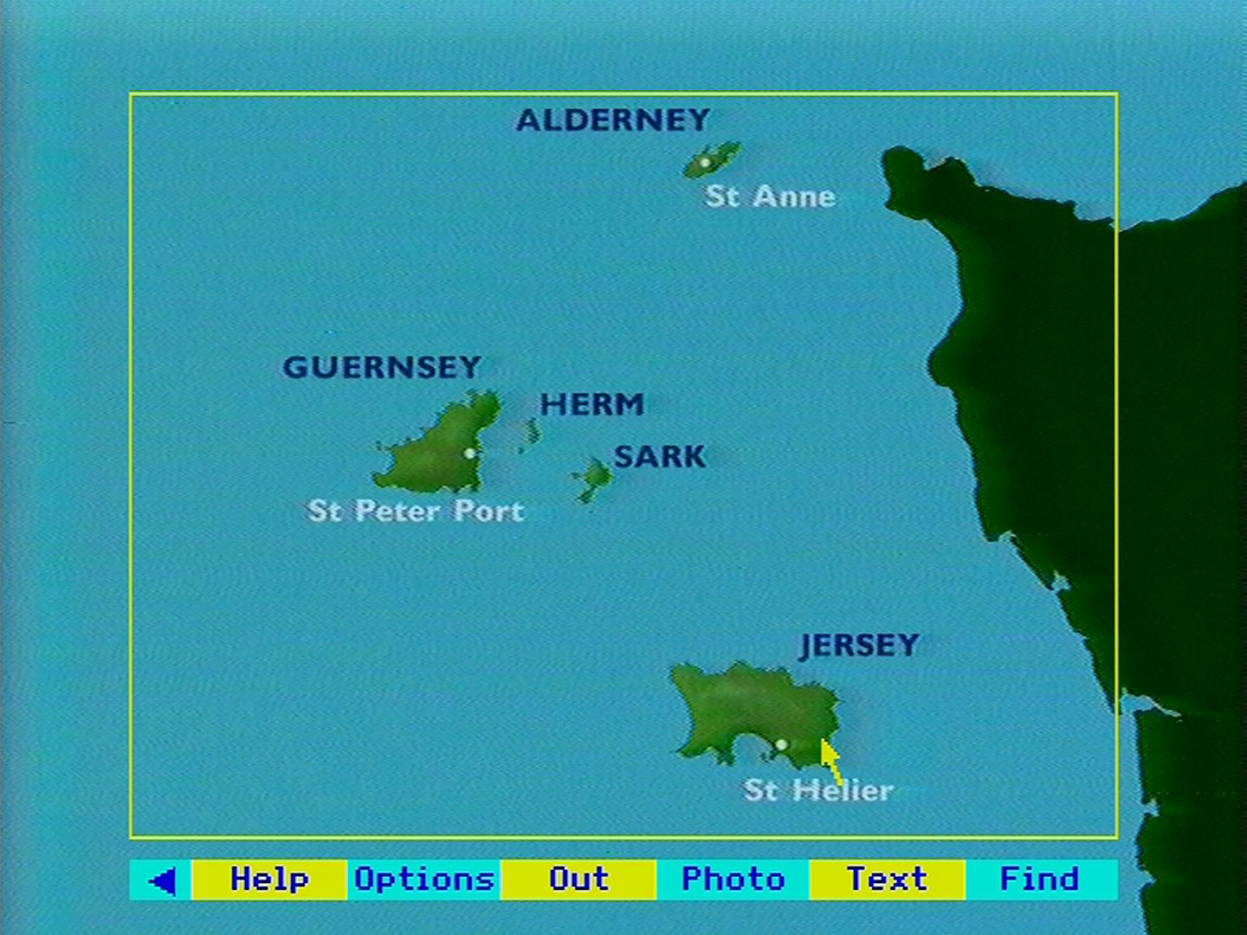
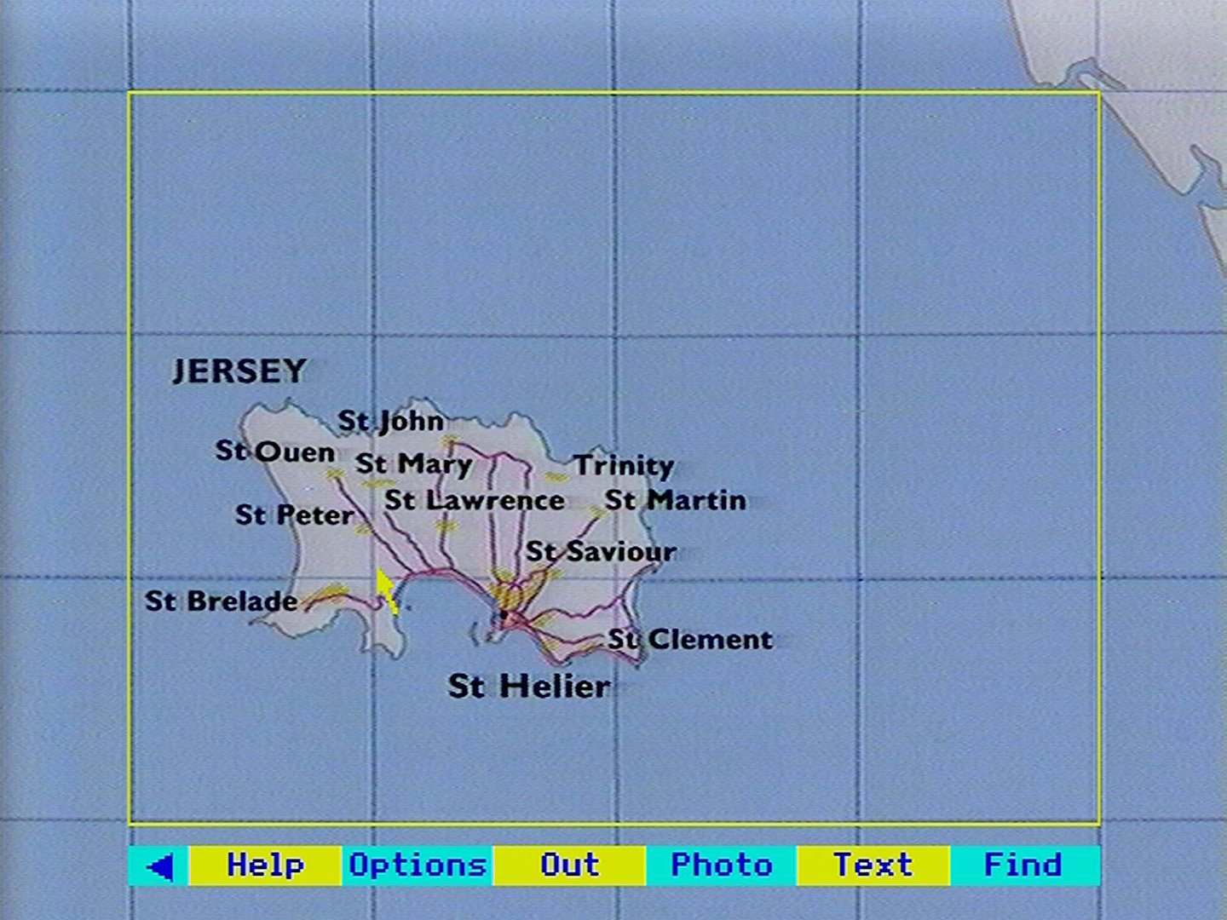
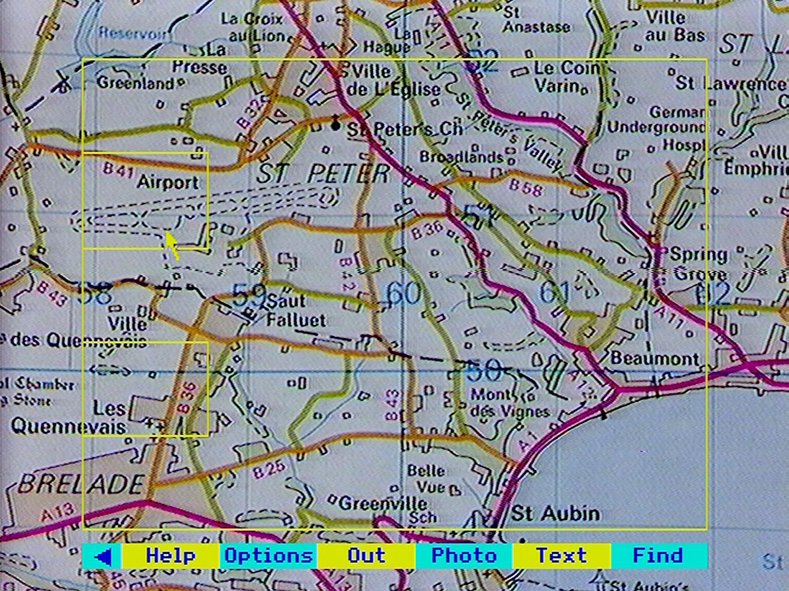
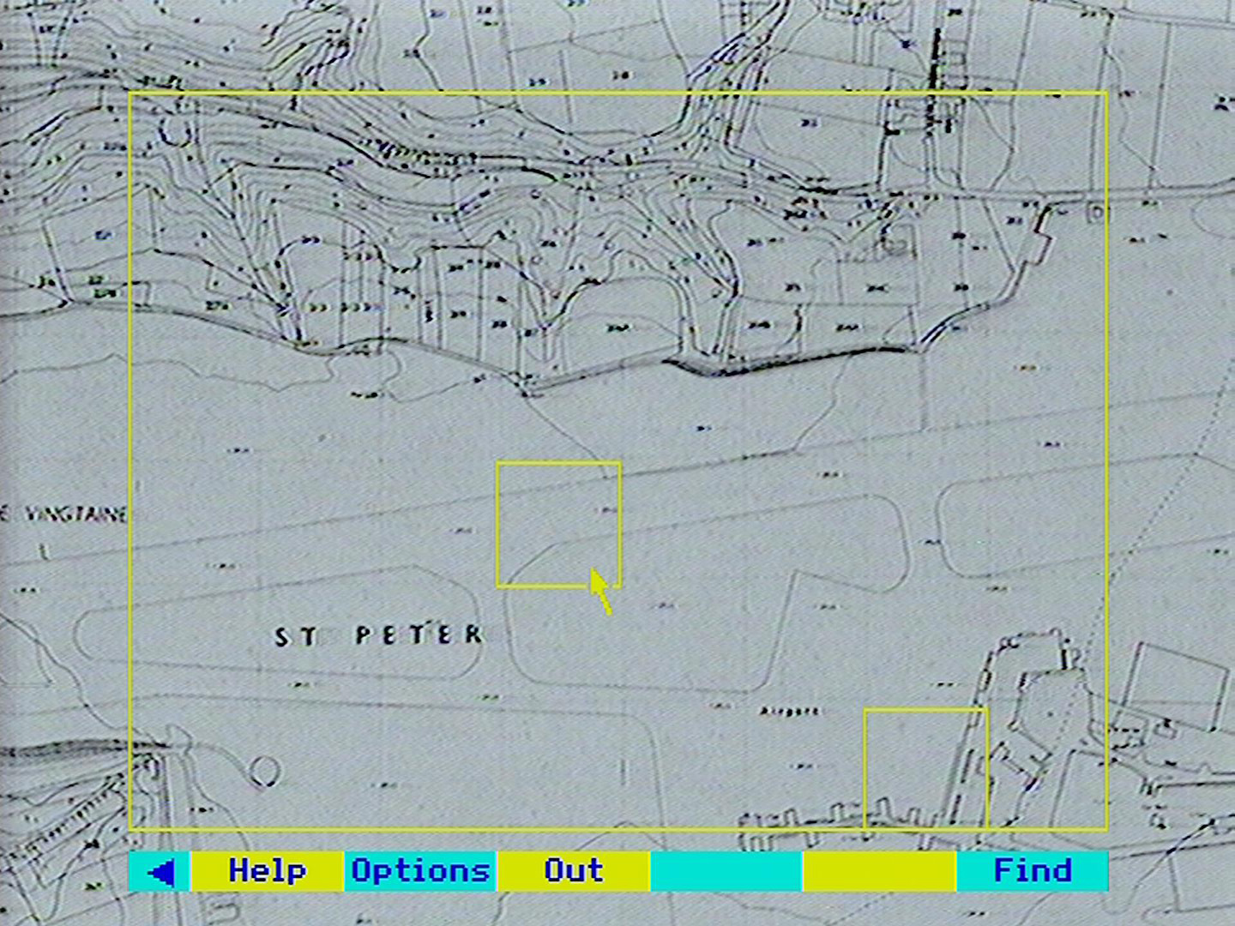
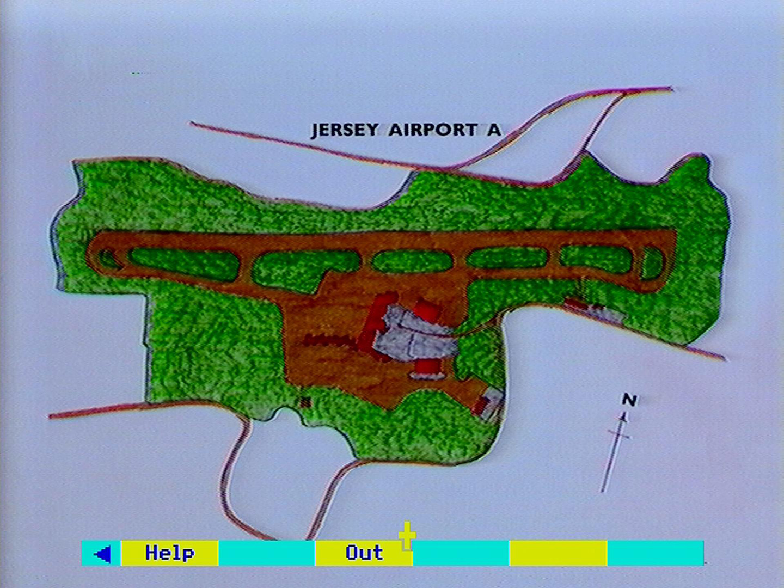
United Kingdom:
specially produced
Level 0
Countries and islands:
specially produced
Level 1
Ordnance Survey 1:625,000
40 x 30km window
Level 2
Ordnance Survey 1:50,000
4 x 3km window
Level 3
Ordnance Survey 1:10,000
.8 x .6km window
Level 4
Produced locally:
mixed scales
Level 5

